Slide 1
Multichannel EEG based Principle Component Sentiment Disorder Detection Model
Cordinator and Internal Guide-
Mr. Vijay Swaroop
Co-Guide- Dr. Jasma B
Presented by,
Aishwarya Raghu(1AT13CS004)
Aishwarya D(1AT13CS006)
Akansha Rana(1AT13CS008)
Anushree Ankola(1AT13CS017)
24-6-2017

Slide 2
Contents
Introduction
Project Scope
System Description
Proposed System
System Requirements
Detailed Design and System Architecture
Sequence Diagram
Conclusion
References

Slide 3
Introduction
An important aspect of interaction between human beings is through sentiment or feelings.
These feelings provide a basis for human experience and play a great role in their daily tasks such as learning, identification and recognition, and making cogent decisions.
Hence studying the sentiment of a person is very crucial.
Detection of a sentiment of a person is difficult, given the possibility that they can be faked. Hence an efficient way of detecting the sentiment is needed.
Thus we collect data from electroencephalogram (EEG) signals.
EEG is an electrophysiological monitoring method to record electrical activity of the brain.

Slide 4
Introduction
For this study, we have taken the EEG dataset from a publicly available platform.
The features of EEG have been extracted into a collection of 32 state variables referring to​ each electrodes.
This data consists of electrical signals that were captured from the 32 electrodes that were placed on the scalps of 14 subjects.
The importance of obtaining EEG signal depends mainly on the places where the necessary signals are captured.
The selection of electrodes which records the sentiments are identified.

Slide 5
Project Scope
The project focuses mainly on its benefits that can be provided to various health institutions.
The main purpose of the proposed system is to carry out the analysis to investigate which type of sentiment an individual possesses while performing a particular task such as categorization and recognition.
It can be used to understand the emotions of autistic or intellectually disabled children.
This system also helps people who suffer from psychological problems to interact and communicate easily with computers and humans by capturing the person's emotion and make the system self adapt based on the user's current emotion.

Slide 6
System Description
EXISTING SYSTEM
There is much work done in the field of emotion and mental state detection by analyzing facial expressions or/and speech
Some of these systems showed a lot of success such as those discussed in “Mind reading machines: automated inference of cognitive mental states from video” and “Real-time emotion detection system using speech: Multi-modal fusion of different timescale features”
The first system uses an automated inference of mental states from observed facial expressions and head gestures in video, while the second system makes use of different timescale features of the speech.
DISADVANTAGES
Although facial expressions are considered to be a very powerful means for humans to communicate their emotions, the main drawback of using facial expressions or speech is the fact that they are not reliable indicators of emotion because they can either be faked by the user or may not be produced as a result of the emotion.

Slide 7
Proposed System
[Authors: Aishwarya Raghu, Aishwarya D Anushree Ankola, Akansha Rana under the guidance of Dr. Jasma Balasangameshwara ]
ADVANTAGES
It uses a system to analyze physiological signals because they are not experiencing the same drawback of video and speech.
This is achieved through the use of EEG, which records neural activity generated by the brain.
It is flexible and reliable.
It is easy to maintain.

Slide 8
System Requirements
Functional Requirements
Input:
EEG data of the subjects captured and imported as a CSV file
Function:
- Identifying the sentimental electrodes i.e. preprocessing the data.
- Reduction of dimensionality of the data into principal components (PCs).
- Analyzing the sentiment of a subject using PCs.
- Overall analysis and optimization of the results.
Output:
- Identifying the positive or negative sentiment of a subject.

Slide 9
System Requirements
Non- Functional Requirements
Performance: The performance of the programs.
Maintainability: The restore status of the programs in case of failure.
Reliability : System gives reliable outputs.
Flexibility : The system works for any amount of data provided in csv format

Slide 10
High-Level Design
1
2
3
PC-RoDx
DEAn
HOPe

Slide 11
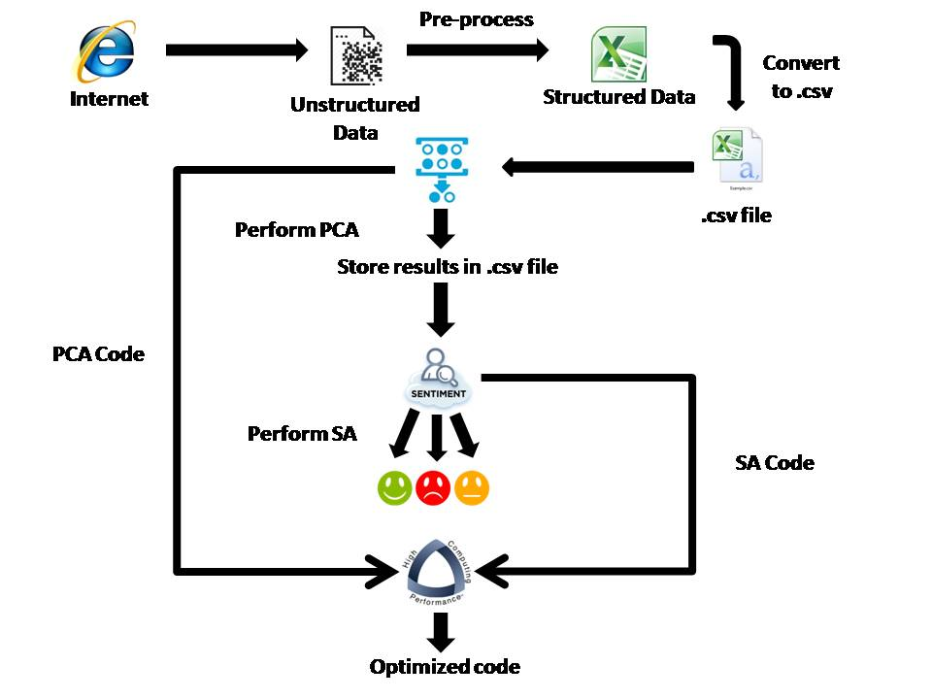
System Architecture

Slide 12
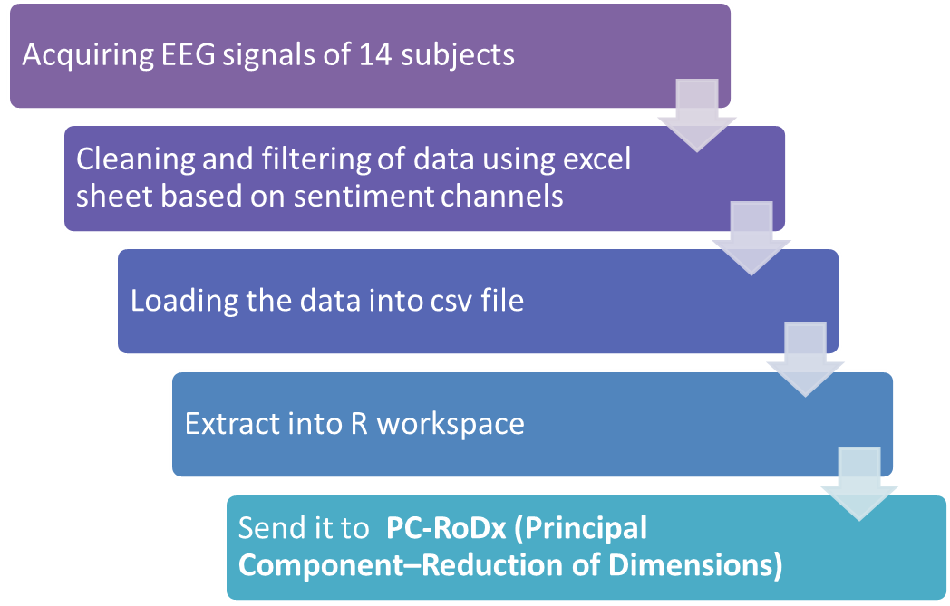
Pre-processing

Slide 13
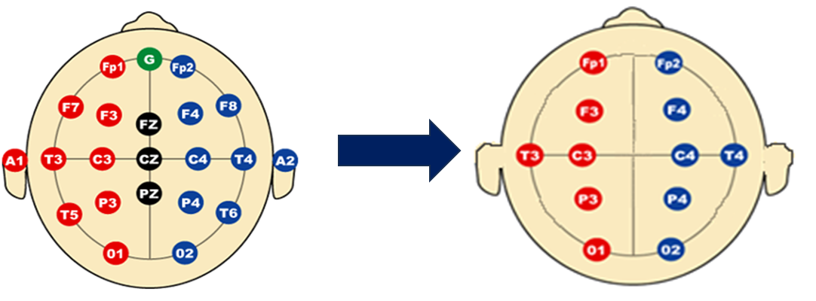
Pre-processing (contd…)
CLEANING AND FILTERING

Slide 14
PC-RoDx
Pc-RoDx stands for Principal Component- Reduction of Dimensions
The underlying technique that was studied to perform PC-RoDx is Principal Component Analysis.
Correlation is a statistical method which enables the researcher to find whether two variables are related and to what extent they are related.
positively correlated,
negatively correlated,
not correlated.
PCA reduces the dimensionality of a data set involving a large number of variables. The original set of variables are transformed into a new set of variables called the principal components (PCs). The PCs are ordered so that the first variables represent most of the variations in the original variables.
This technique is especially useful when the variables within the data set are highly correlated (either positive and negative correlation)

Slide 15
PC-RoDx (contd..)
All the principal components need to be kept. According to the cumulative proportion of explained variance criterion, that suggests to retain as many PCs as are needed in order to explain approximately 80 to 90% of the total variance.
Kaiser Criterion
Scree Plot
Here there are two general methods to perform PCA without any missing values:
spectral decomposition
singular value decomposition
The singular value decomposition method is the preferred analysis for numerical accuracy .
For our project, we extract rotations or loadings from an R function which uses svd.
Loadings are coefficients in linear combination predicting a variable by the (standardized) components

Slide 16
PC-RoDx (contd…)
Choose a subject whose sentiments has to be retrieved
Receive input from pre-processed stage
Obtain correlation between electrodes
Perform PCA and thus obtain variance
Store the result in csv file
Send this as input to DEAn

Slide 17
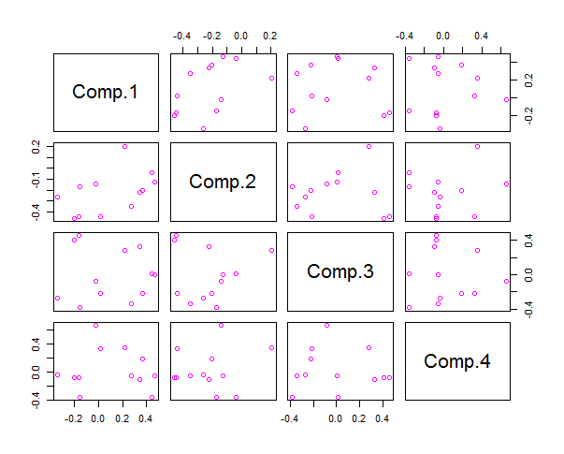
PC-RoDx - Results
SCATTER PLOT
Scatterplots are useful for interpreting
trends in statistical data. Each observation (or point) in a scatterplot has two coordinates;
The first corresponds to the first piece of data in the pair (that’s the X coordinate; the amount that you go left or right).
The second coordinate corresponds to the second piece of data in the pair (that’s the Y-coordinate; the amount that you go up or down).
The point representing that observation is placed at the intersection of the two coordinates.
Correlation graph of subject CBA

Slide 18
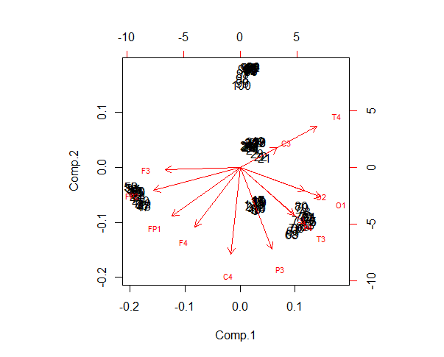
PC-RoDx - Results
BIPLOT
A Biplot is an enhanced scatterplot that uses both points and vectors to represent structure.
As used in Principal Component Analysis, the axes of a biplot are a pair of principal components. These axes are drawn in black and are labled PC1, PC2, etc
.
A biplot uses points to represent the scores of the observations on the principal components, and it uses vectors to represent the coefficients of the variables on the principal components.

Slide 19

DEAn
The second model DEAn stands for “Detection of Emotions and its Analysis” which uses an analysis technique known as Sentiment Analysis.
Sentiment Analysis is a technique that helps us in analyzing the sentiments of a subject which can either be a positive, negative or neutral sentiment.
A basic task in sentiment analysis is classifying the polarity of a given text at the document, sentence, or feature/aspect level—whether the expressed opinion in a document, a sentence or an entity feature/aspect is positive, negative, or neutral.
A common use case for this technology is to discover how people feel about a particular topic. Sentiment Analysis has also been useful in many other areas like Politics/political science, Law/policy making, Sociology and Psychology.

Slide 20
DEAn (contd…)
Input from PC-Rodx (PCs)
Perform sum of PCs
Analysing Sentiments
Positive Sentiment
Neutral Sentiment
Negative Sentiment

Slide 21
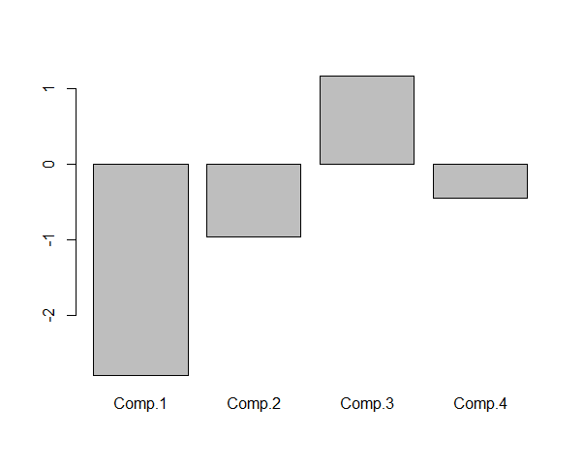
DEAn - Result
BAR GRAPH
The bar plot helps us in knowing whether the person was happy or sad during the experiment.
The plot above the point 0 shows that the sentiment of the subject is positive whereas the plot below 0 represents a negative sentiment.
The results can either be in series or randomly generated. These results may vary as the model PC-RoDx generates random set of principal components every time it is calculated.

Slide 22
HOPe
High Performance Computing most generally refers to the practice of aggregating the computing power in a way that delivers much higher performance than one could get out of typical desktop computer or a workstation in order to solve large problems in science, engineering or even business.
In other words HPC can also be defined as the use of parallel processing for running advanced application programs efficiently, reliably and quickly.
For High Performance Computing, we have implemented a model called HOPe. HOPe stands for Highly Optimized Performance which is a model to increase the accuracy, reliability and hence reduce the time and space a given model or a piece of code would consume.
Few of the techniques for implementing HPC in our model HOPe are as follows:
1) Profiling R code
2) Using Time_sys function
3) Memory Profiling

Slide 23
HOPe (contd…)
HPC
Profiling
PC-RoDx
DEAn
Time_sys
Mem_profiling
Optimized Code

Slide 24
HOPe (contd…)
Profiling R code
Profiling R code gives you the chance to identify bottlenecks and pieces of code that needs to be more efficiently implemented.
The traditional way to collect profiling data in R is to call Rprof to start profiling, run the code to be profiled, and then call Rprof again to end profiling.
Rprof works by recording at fixed intervals (by default every 20 msecs) which R function is being used, and recording the results in a file.
The most basic summary function is summaryRprof for summarizing profile results.
summaryRprof will give you a list with five elements:
1. by.self: the time spent in function alone.
2. by.total: the time spent in function and callees.
3. by.line: the time spent in that line of code.
4. sample.interval: the sampling interval, by default every 20 msecs.
5. sampling.time: the total time of profiling run.

Slide 25
HOPe (contd…)
Using Time_sys function
The time_sys() is a user defined function which comprises of a standard R function called system.time().
The system.time() is used to find the time taken for each function to process or in other words, it is used to time how fast R processes an expression or a function.
However, the system.time() command takes a single R expression as its argument.
The output of this function is the user, system and the elapsed times.

Slide 26
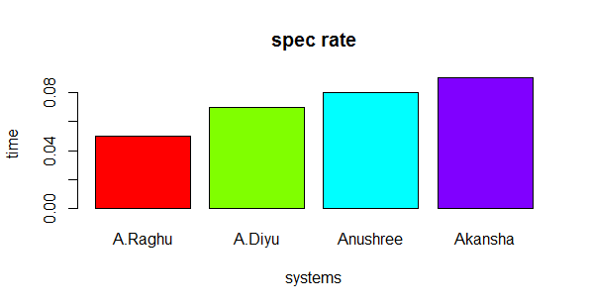
HOPe - Result
BAR PLOT
The proposed model is tested on 4 different systems and their efficiencies are compared.

Slide 27
Sequence Diagram
USER
PC-Rodx
DEAn
Pre-processed EEG Data
Principal components (PCs)
Positive/Negative Sentiments are displayed

Slide 28
Conclusion
This system was mainly developed with a motive to identify the sentiment of different individuals undergoing any experiment.
Emotion assessment can be integrated in human computer interaction systems that will lead to improve these systems by making them get close to human-human interaction. This will enhance the usability of the systems and improve the quality of life of disabled people who find difficulty in using the interfaces provided to healthy people.
Capturing users’ emotions can be helpful in quantifying customers’ experience.
This system can be helpful for people who suffer from psychological problems to interact and communicate easily with computer.
The proposed system is a major step towards making a big difference in the fields of healthcare and education and we hope to achieve this milestone that would be a boon to the society.

Slide 29
References
Real Time Emotion Detection using EEG by Mina Mikhail EEGSentimentAnalyisLiteratureSurvey.pdf
Electroencephalography - www.wikipedia.org
10-20 system (EEG)- https://en.wikipedia.org/wiki/10-20_system_%28EEG%29
Sentiment analysis- https://en.wikipedia.org/wiki/Sentiment_analysis
D. Nie, X. W. Wang, L. C. Shi and B. L. Lu, "EEG-based emotion recognition during watching movies," 2011 5th International IEEE/EMBS Conference on Neural Engineering, Cancun, 2011, pp. 667-670.
Gregory B. Anderson, “PRINCIPAL COMPONENT ANALYSIS IN R”, An examinational of all the different functions and methods to perform PCA
I Smith, Lindsay. “A tutorial on Principal Components Analysis”, February 26, 2002
Code Proﬁling in R: A Review of Existing Methods and an Introduction to Package GUI Proﬁler by Angel Rubio an http://stats.idre.ucla.edu/r/faq/how-can-i-time-my-code/d Fernando de Villar
Profiling and benchmarking in R: http://adv-r.had.co.nz/Profiling.html
R. El Kaliouby and P. Robinson, Mind reading machines: automated inference of cognitive
mental states from video, in 2004 IEEE International Conference on Systems, Man and Cybernetics Vol1
S. Kim, P. Georgiou, S. Lee, and S. Narayanan, Real-time emotion detection system using
speech: Multi-modal fusion of different timescale features, in IEEE 9thWorkshop on Multimedia
Signal Processing, 2007. MMSP 2007, pp. 48{51, 2007.

Slide 30
Thank You !
24 – 06 - 2017

